Slide 1

Module 7
Abstraction and Console App Classes

Slide 2
Content (slot 2)
Putting It All Together
Common Mistakes

Slide 3
7.5 Putting It All Together
The problem description: Design and implement a class to represent a single die. You also need to provide the standard die operations for the class.
Understand the Problem
How many sides should the die have?
A standard die has 6 sides, but you can purchase dice of many different numbers of sides (especially if you want to roll to find out the damage the evil Orc has just inflicted <grin>). Let’s make the default die a six-sided die, but also provide the capability to create a die of any integer number of sides.
What are the standard die operations?
Rolling a die and seeing which side is on top are the only common die operations.
How many does sides the die has?

Slide 4
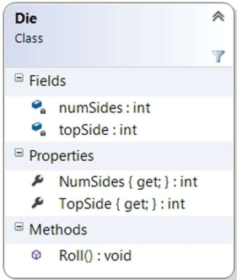
7.5 Putting It All Together
Design a Solution
Die UML Diagram

Slide 5
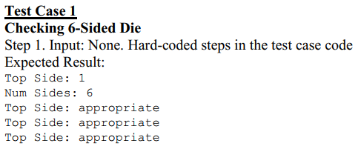
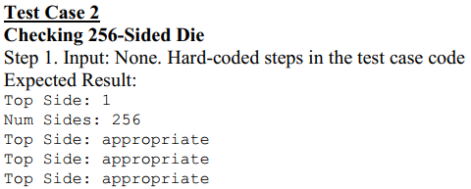
7.5 Putting It All Together
Write Test Cases

Slide 6
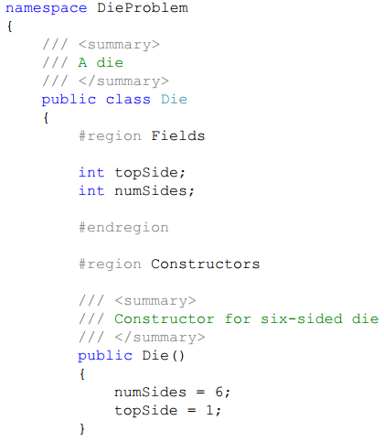
7.5 Putting It All Together
Write the Code

Slide 7
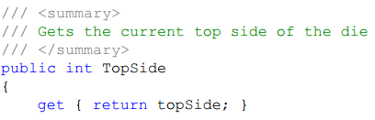
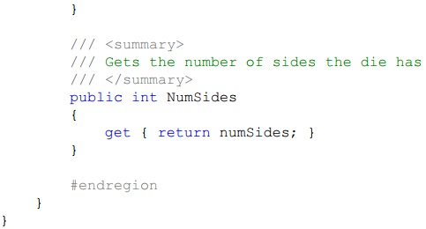
7.5 Putting It All Together
Write the Code

Slide 8
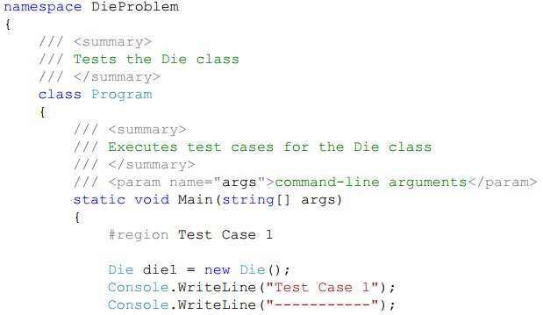
7.5 Putting It All Together
Test the Code
class with Test Case 1 partially implemented

Slide 9
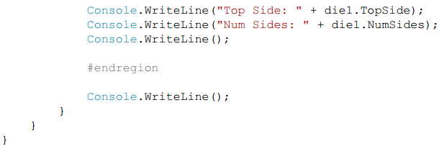

7.5 Putting It All Together
Test the Code
class with Test Case 1 partially implemented
Test Case 1 Partial Output

Slide 10

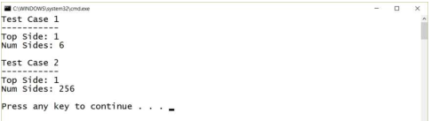
7.5 Putting It All Together
Write the Code, Part 2
Add the constructor that takes in the number of sides as a parameter
Test the Code, Part 2

Slide 11


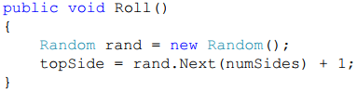
7.5 Putting It All Together
Write the Code, Part 3
Check out the new constructors
Test the Code, Part 3
Add the Roll method

Slide 12
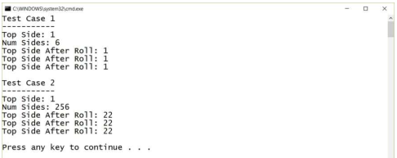
7.5 Putting It All Together
Test the Code, Part 4

Slide 13
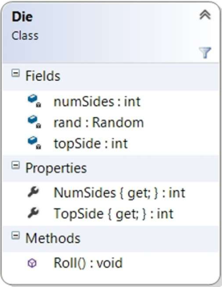
7.5 Putting It All Together
Write the Code, Part 5
Revised Die UML Diagram

Slide 14
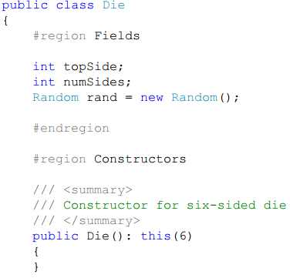
7.5 Putting It All Together
Write the Code, Part 5

Slide 15
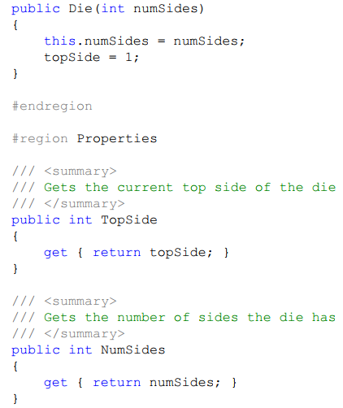
7.5 Putting It All Together
Write the Code, Part 5

Slide 16
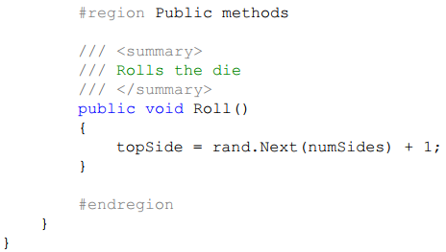
7.5 Putting It All Together
Write the Code, Part 5

Slide 17
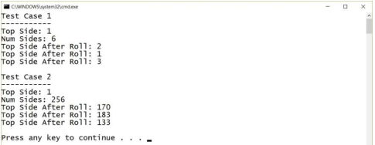
7.5 Putting It All Together
Test the Code, Part 5
Test Cases 1 and 2 Output

Slide 18
7.6 Common Mistakes
Trying to Return Something from a Constructor
If we add a return type to our constructors, the compiler views them as “normal” methods rather than constructors, and they won’t be called when you try to create an instance of the class.
Forgetting to Use this When Assigning to an Instance Variable
This is really only an issue when the instance variable has the same name as a parameter, but that happens a lot, especially with constructors. If you forget the this the code will compile and run, it just won’t do what you want it to do!
Trying to Access an Instance Variable from a Static Method
Remember, static methods are only allowed to access static variables, not instance variables. If you find you really need to do this, you need to change your class design to either provide a static variable to hold the information you need or change the static method to an instance method.

Slide 19
Summary
Fields
Properties
Constructors and Other Methods

